Slide 1
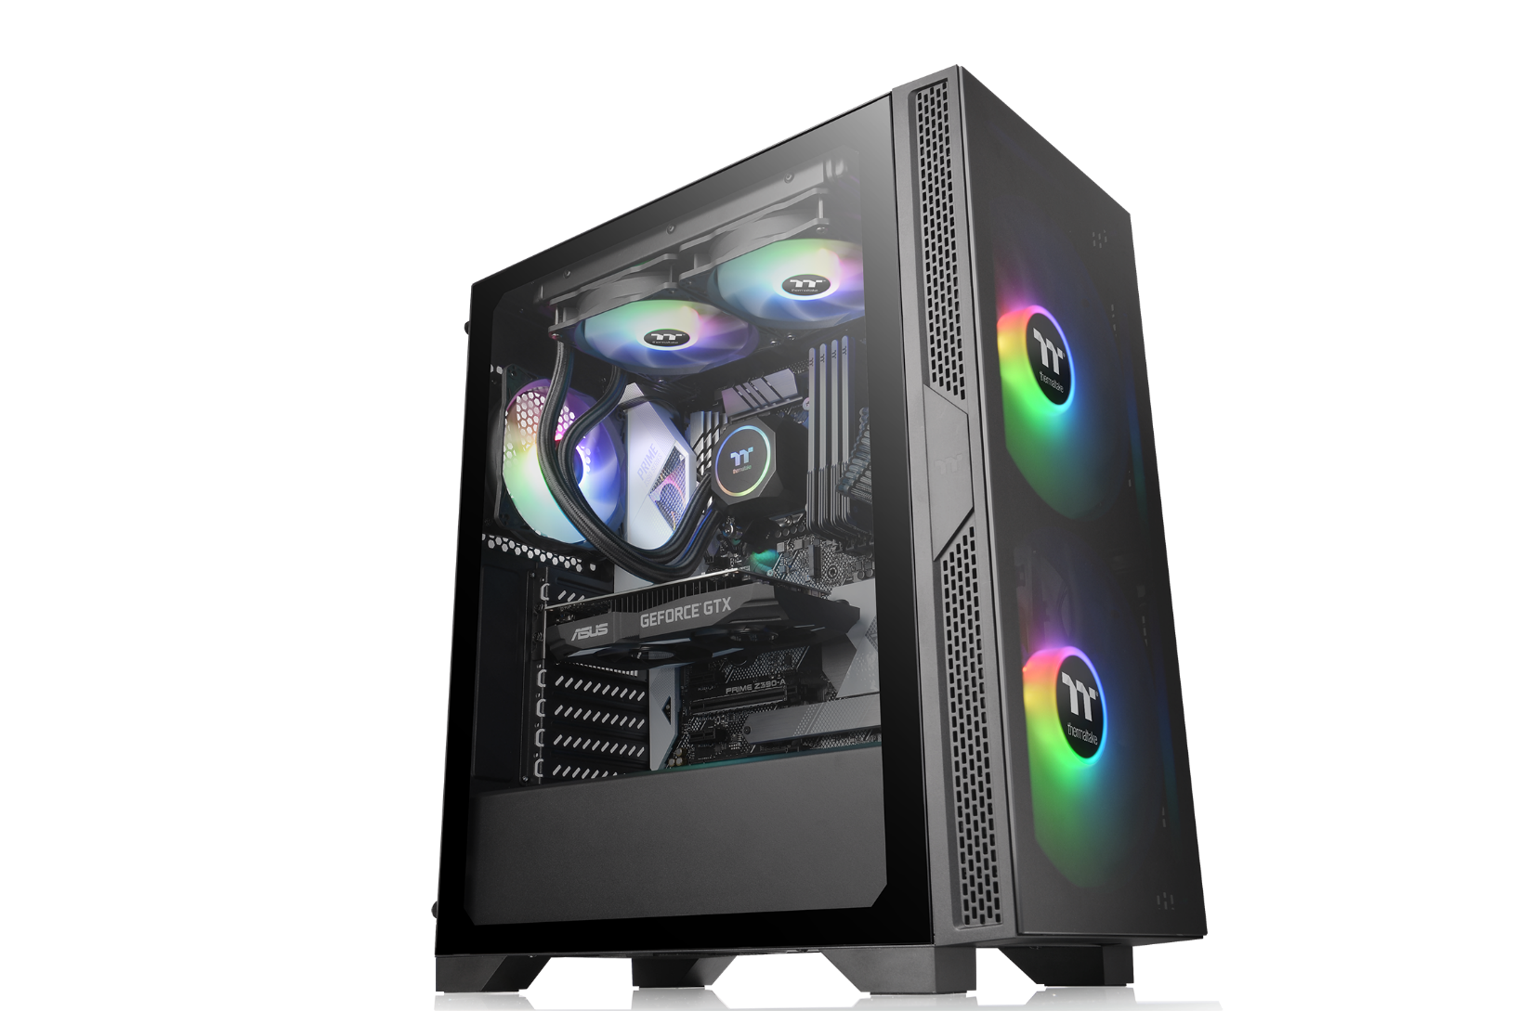
Thermaltake Versa T25 TG Middle tower
Style：Simple
Size： Middle tower support up to ATX MB
Material： Steel & Plastic & Tempered Glass
Main Feature
Connection ： Top-Front I/O ports with 1 x USB 3.0, 2 x USB 2.0
Ventilation ： 1 preinstalled 120mm fan
Support ：Advance Cable Management

Slide 2
Thermaltake Versa T25 TG Middle tower
Specification
Model | Versa T25 TG w/600W PSU
P/N | CA-3R5-60M1WU-00
Case Type | Middle tower
Chassis Dimension (H*W*D) | 416 x 210 x 480 mm (16.38 x 8.27 x 18.9 inch)
Net Weight(Case) | 6.65 kg / 14.66 lbs.
Side Panel | 4mm Tempered Glass x2(Left & Front)
Color | Exterior & Interior : Black
Material | SPCC
Cooling System | Rear (exhaust) : 1 x 120 x 120 x 25 mm fan (1000rpm, 16 dBA)
Drive Bays -Accessible -Hidden | 2 x 3.5“ or 2.5” (HDD Rack); 2 x 2.5” (HDD Bracket)
Expansion Slots | 7
Motherboards | 6.7” x 6.7” (Mini ITX), 9.6” x 9.6” (Micro ATX), 12” x 9.6” (ATX)
I/O Port | 1 x USB 3.0, 2 x USB 2.0, 1 x HD Audio,
PSU | PS-TTP-0600NNFANU-1
Fan Support | Front: 3 x 120mm or 2 x 120mm or 1 x 120mm 2 x 140mm or 1 x 140mm 2 x 200mm or 1 x 200mm Top: 2 x 120mm or 1 x 120mm 2 x 140mm or 1 x 140mm Rear: 1 x 120mm,
Radiator Support | Front: 1 x 360mm or 1 x 240mm or 1 x 120mm 1x 280mm or 1 x 140mm Top: 1 x 240mm or 1 x 120mm Rear: 1 x 120mm
Clearance | CPU cooler height limitation: 150mm PSU length limitation: 160mm(With HDD Rack) 200mm(Without HDD Rack) VGA length limitation: 300mm RAM height limitation: 60mm(With radiator series)

Slide 3

Thermaltake Versa T25 TG Middle tower
Packaging
Package Information | Versa T25 TG w/600W PSU
EAN Code | 4713227526890
UPC Code | 841163076903
N.W | 6.65 kg / 14.66 lbs.
G.W | 7.75 kg / 17.09 lbs.
Carton Size (L x W x H) | 536 x 272 x 480 mm / 21.1 x 10.7 x 18.9 inch
Cuft | 2.47
Container | W/O pallet
20’ | 360
40’ | 810
40’ HQ | 950

Slide 4
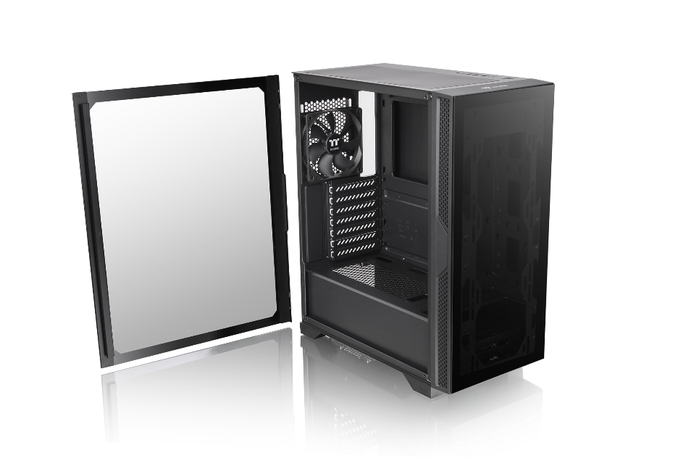
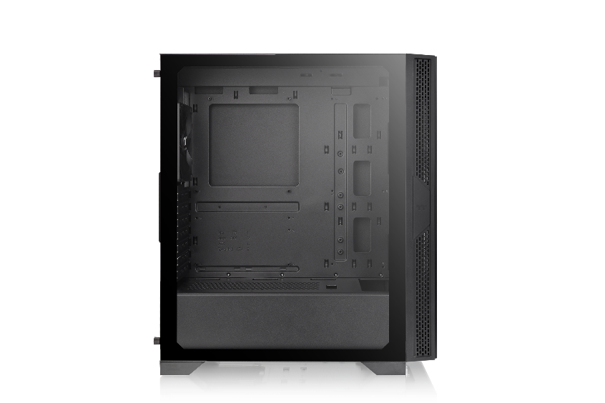
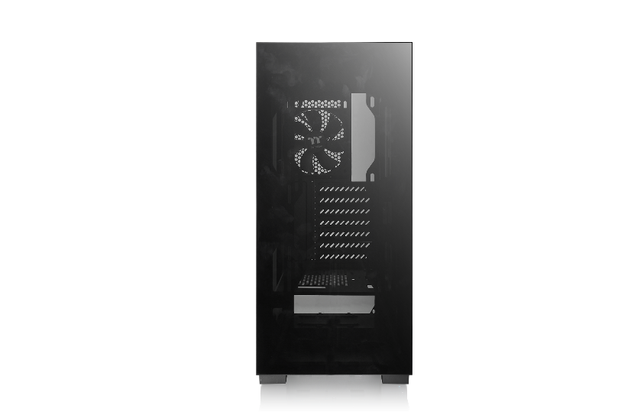
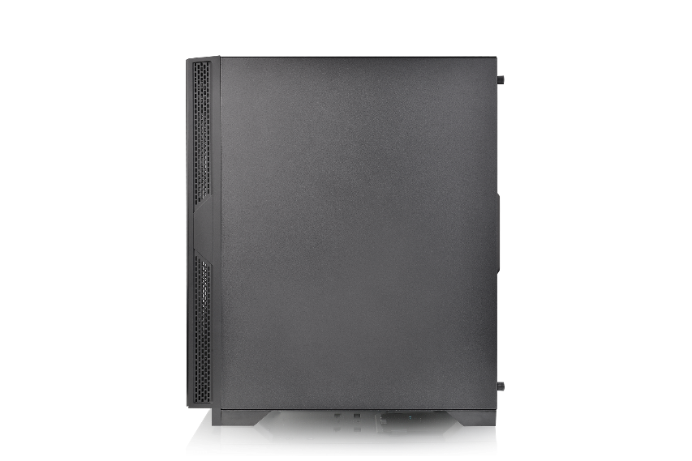
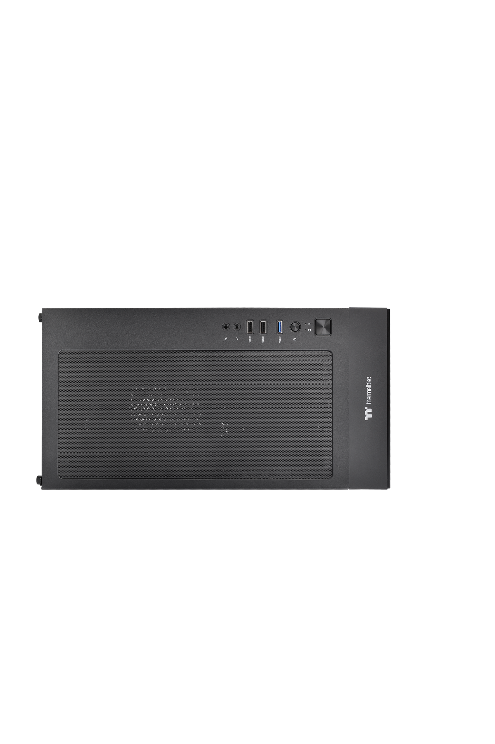
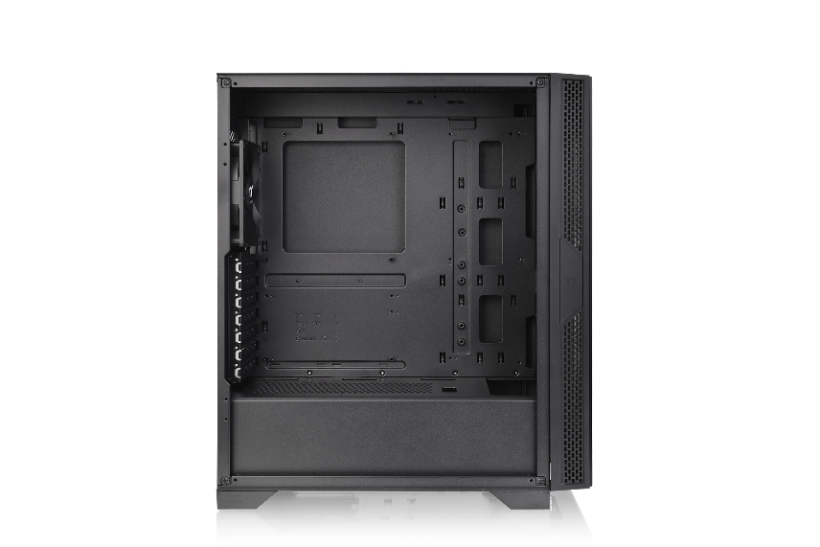
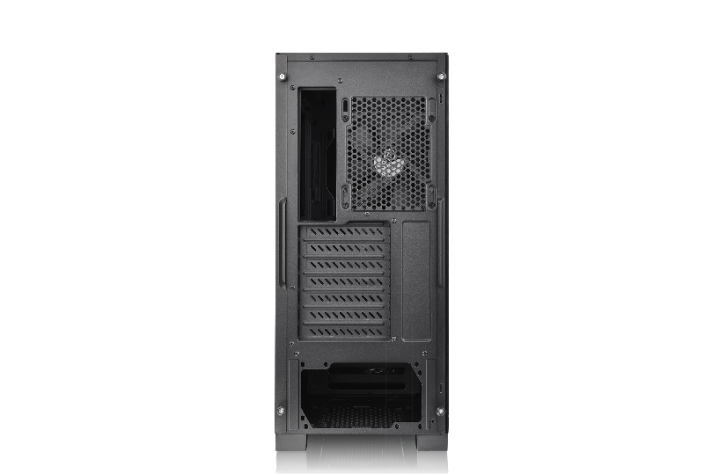
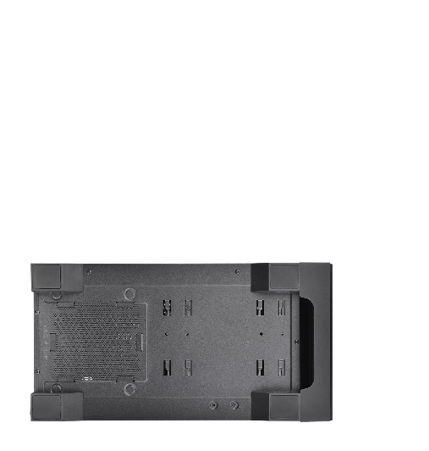
Thermaltake Versa T25 TG Middle tower
Appearance - CA-1R5-00M1WN-00
Angle view
Left Side view
Front view
Right Side view
Top view
Internal Structure
Rear view
Bottom view

Slide 5
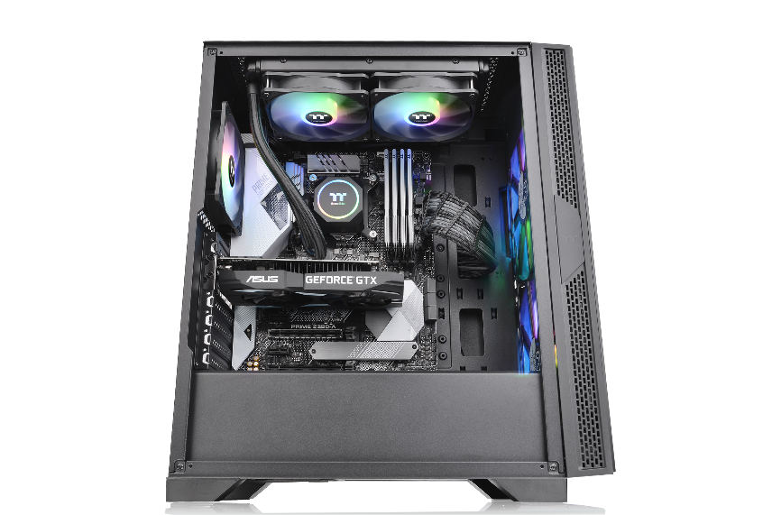
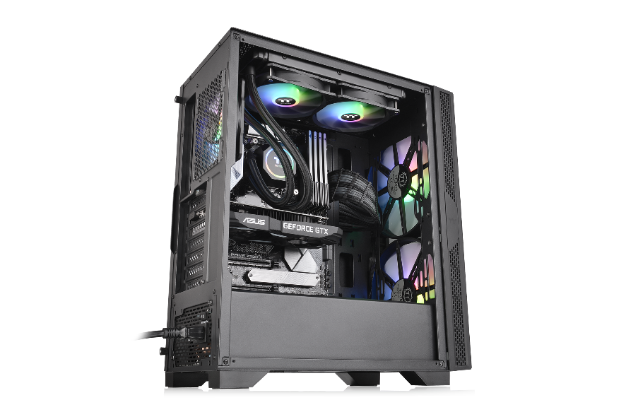

Thermaltake Versa T25 TG Middle tower
Unique Design
Maximum support up to 6 x 120 mm fan
Maximum radiator support up to 360mm
2 x Tempered Glass
( Left & Front)

Slide 6
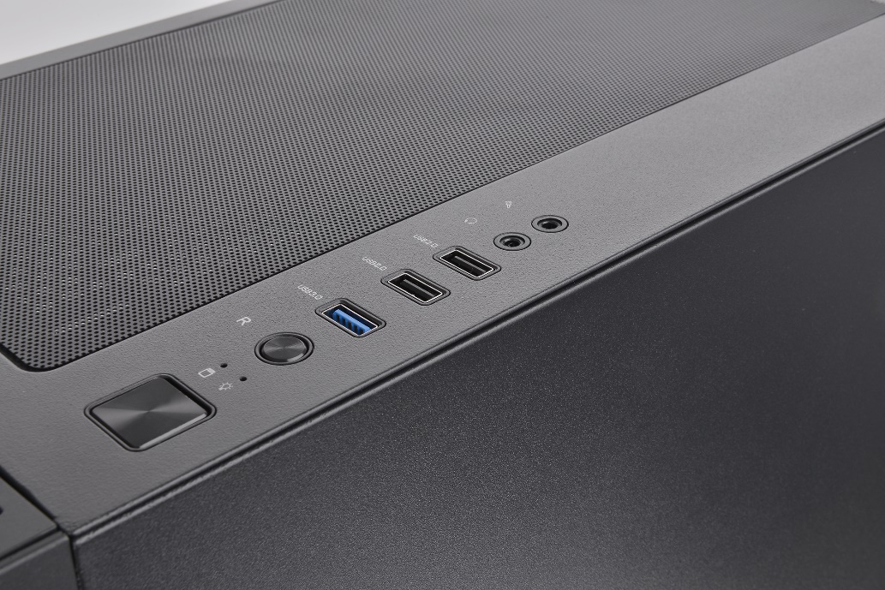
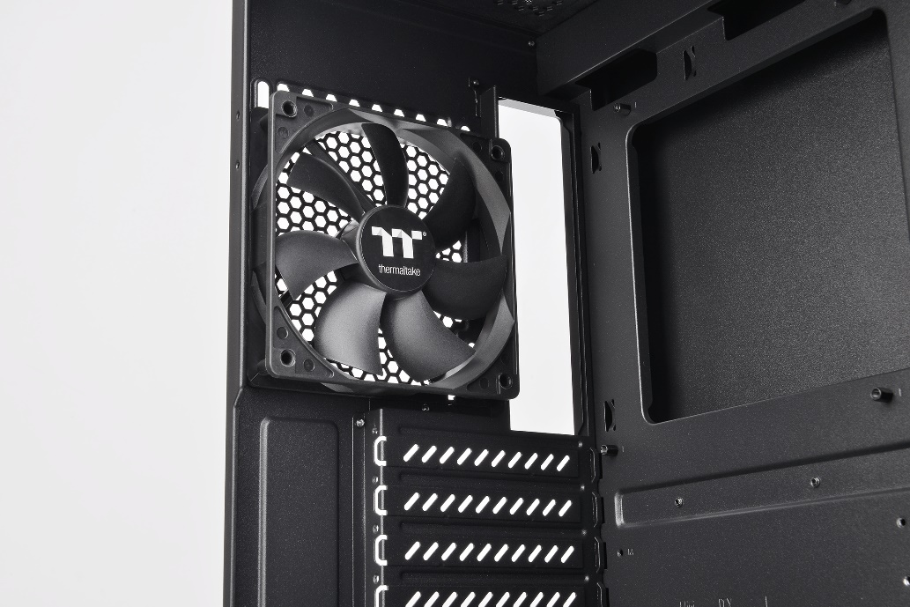
Thermaltake Versa T25 TG Middle tower
Structure (External)
USB connector
One 120mm rear fan

Slide 7
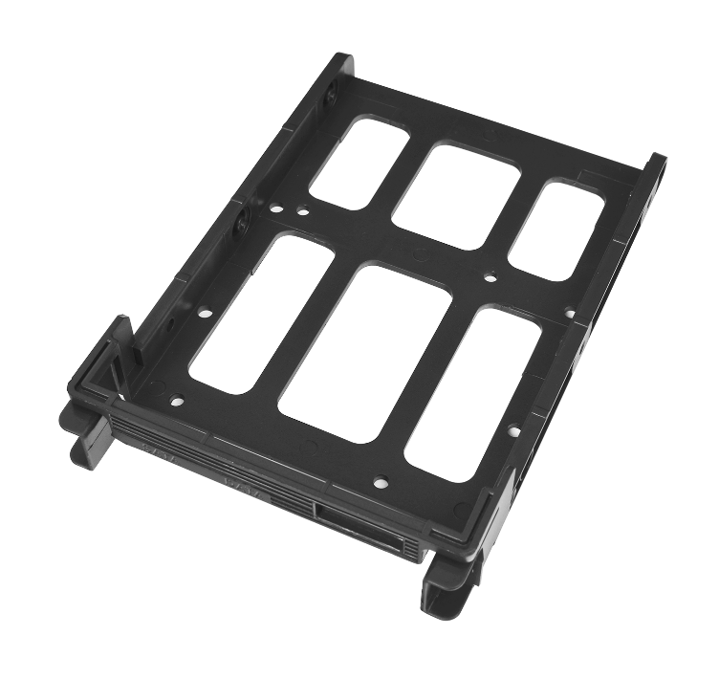
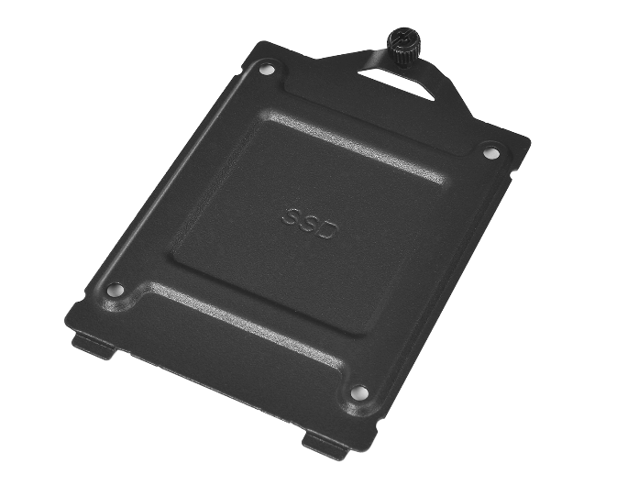
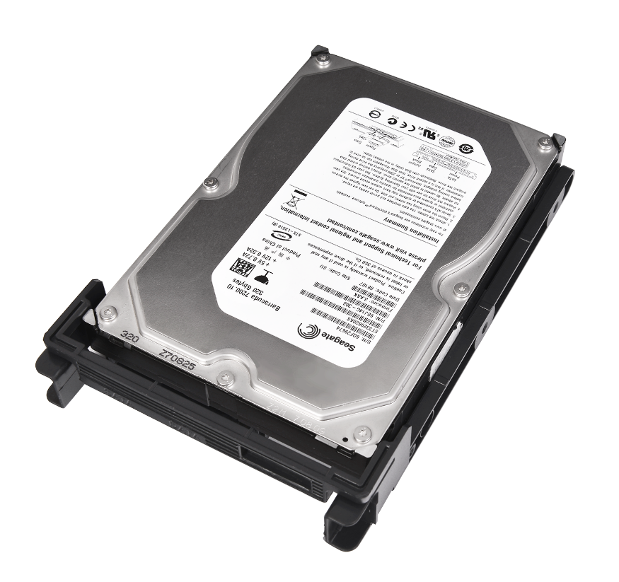
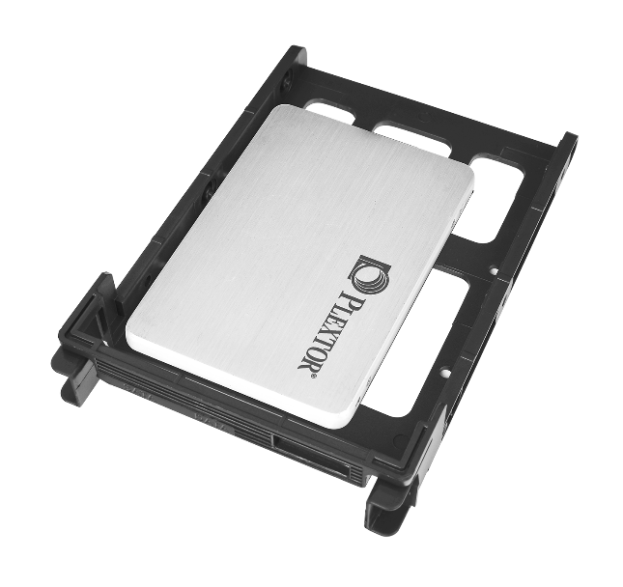
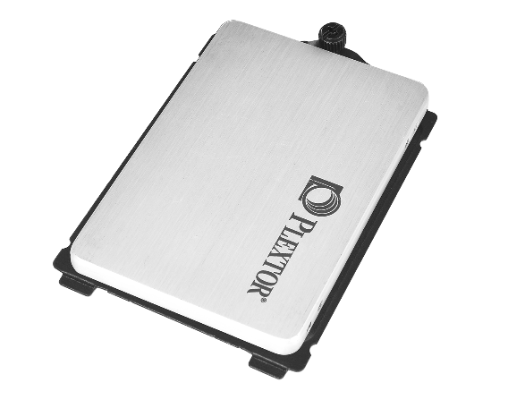
Thermaltake Versa T25 TG Middle tower
HDD expansion introduction
HDD Bracket

Slide 8
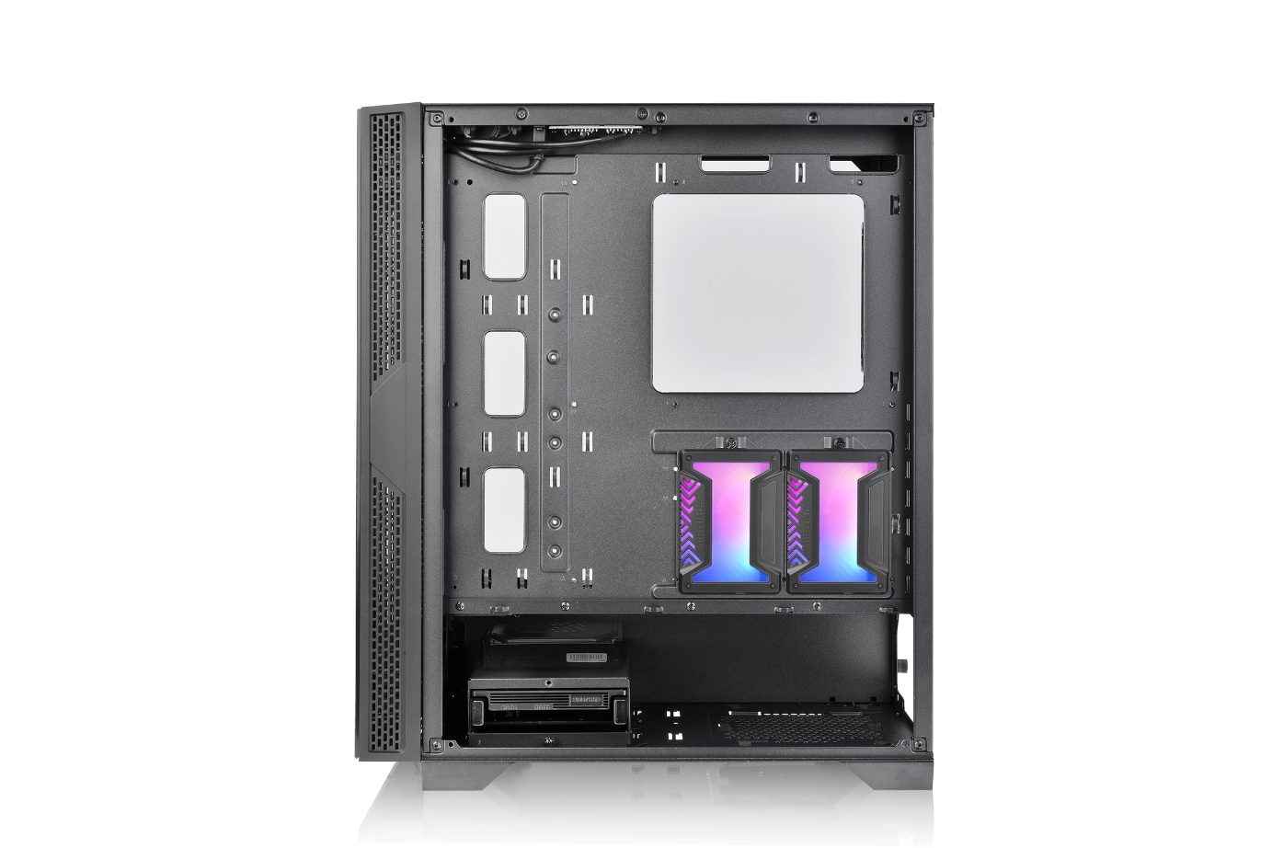
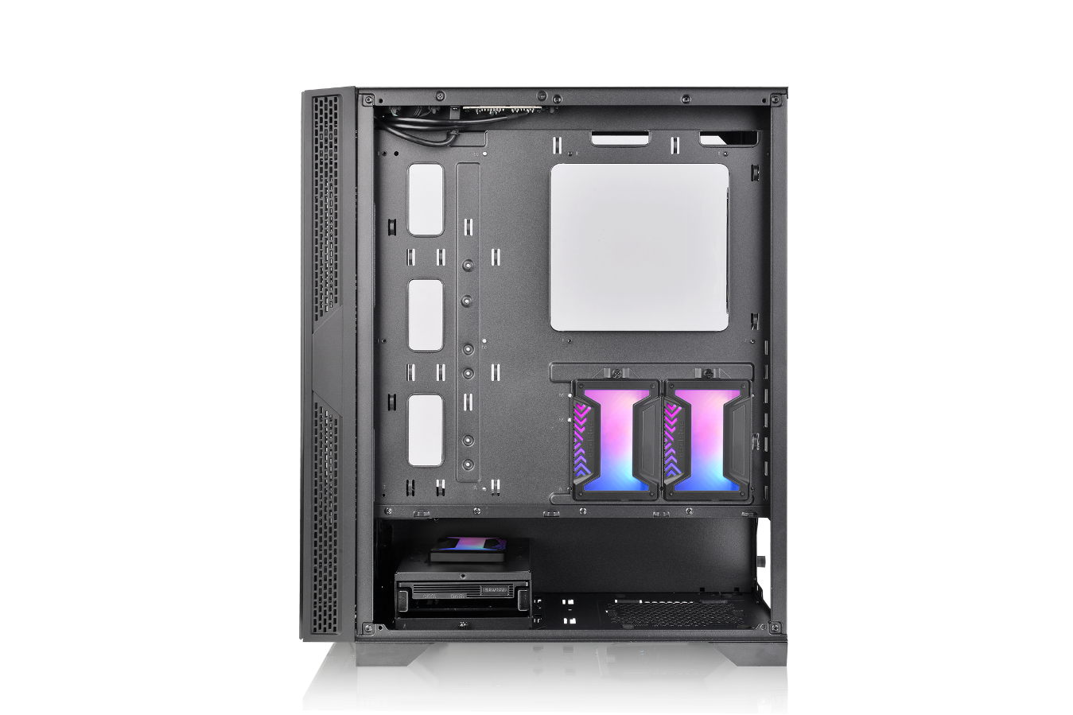
Thermaltake Versa T25 TG Middle tower
HDD expansion introduction
Application

Slide 9
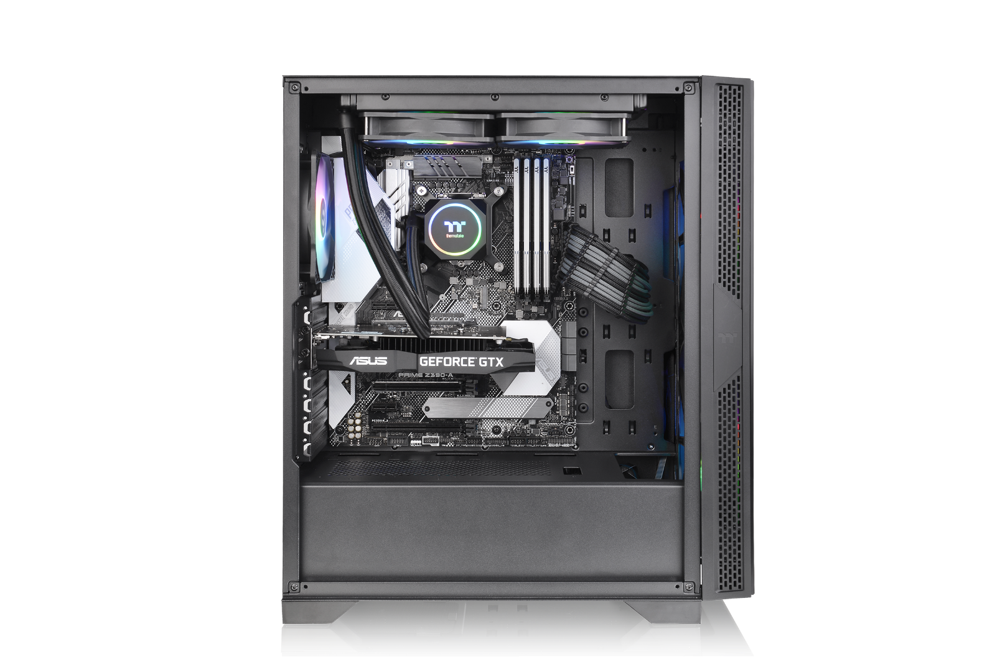
Thermaltake Versa T25 TG Middle tower
The Cooling System – AIO Liquid Cooling (Optional)
A
B
A
CPU Air Cooling System
Rear (exhaust) : 120 x 120 x 25 mm ARGB fan x 1 (1000rpm, 16dBA)
B
HDD Air Cooling System
Front (intake) : 200 x 200 x 30 mm ARGB fan x 2 (600rpm, 29.2 dBA)

Slide 10
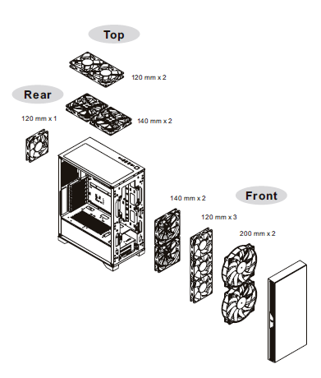
Thermaltake Versa T25 TG Middle tower
Fan compatibility

Slide 11
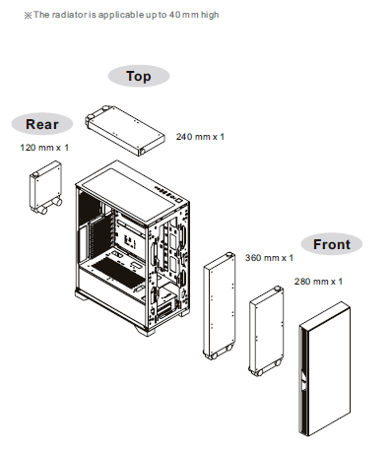
Thermaltake Versa T25 TG Middle tower
Radiator compatibility

Slide 12
Thermaltake Versa T25 TG Middle tower
Compatibility List
Fan Compatibility List
 | 120mm | 140mm | 200mm
Front | 3 | 2 | 2
Top | 2 | 2 | -
Rear | 1 | - | -
Thermaltake Compatible Fan
 | 120mm | 140mm | 200mm
PURE FAN Series | ● | ● | ●
Riing FAN Series | ● | ● | ●
Radiator Compatibility List
 | 120mm | 240mm | 360mm | 140mm | 280mm | 420mm
Front | ● | ● | ● | ● | ● | -
Top | ● | ● | - | - | - | -
Rear | ● | - | - | - | - | -
All-in-One Compatibility List (Water 3.0 and Floe series)
 | Performer | Pro | 240 Series | 360 Series | 140 Series | 280 Series
Front | ● | ● | ● | ● | ● | ●
Top | ● | ● | ● | - | - | -
Rear | ● | ● | - | - | - | -

